Slide 1
Lesson Flow
Show teacher example
Show student remix project
Students remix project
Students add in 2/4/6 items -
Stop
Show how to implement gravity/velocity logic
Students decide on how much bounciness, each item, decide on mass of each item
Extension - add an event handler for alarm button
add object to spin outs side room
Things to consider -
hide one of the locked panels/walls so students can see into room
remind students of editing tools zoom in/out, shortcuts to see whole scene
make sure all items have physics and code enabled
make sure function is labelled correctly e.g if named item that code reflects that e.g for all items in gravity push items with up velocity + 10 or for all elements in gravity apply for each element velocity + 10

Slide 2
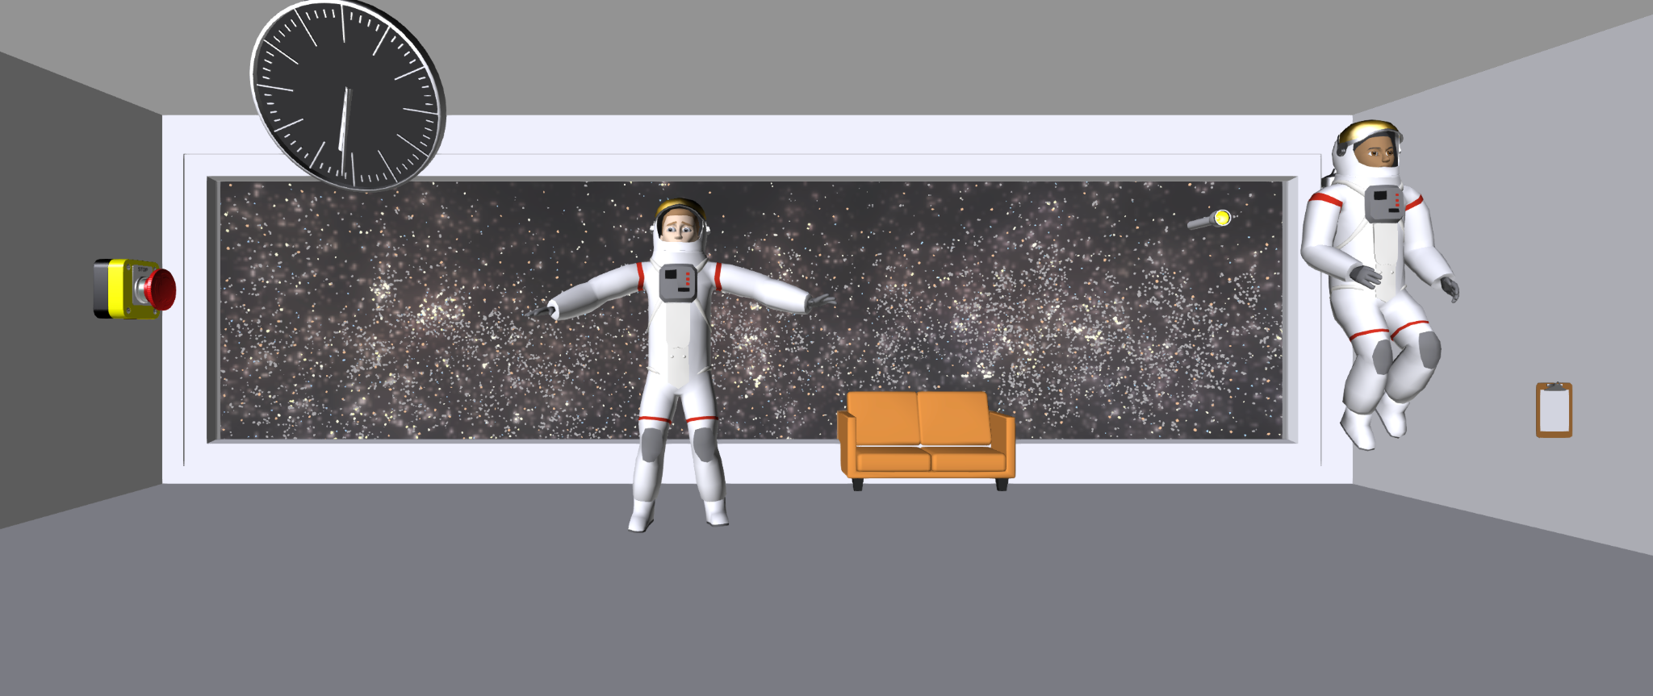
Gravity Control Room: Mastering Game Physics
https://edu.delightex.com/NVW-BYA
Notes:
In this lesson, we're building a "Gravity Control Room" to understand how to make game objects move and interact just like in the real world.

Slide 3
Learning Objectives
Organize elements with Lists
Implement Realistic Collisions
Lists
list as a container that holds many items
lists help you manage multiple game objects
Collision Detection
How your game knows when two objects touch
Essential for making things bounce, break, or stop!

Slide 4
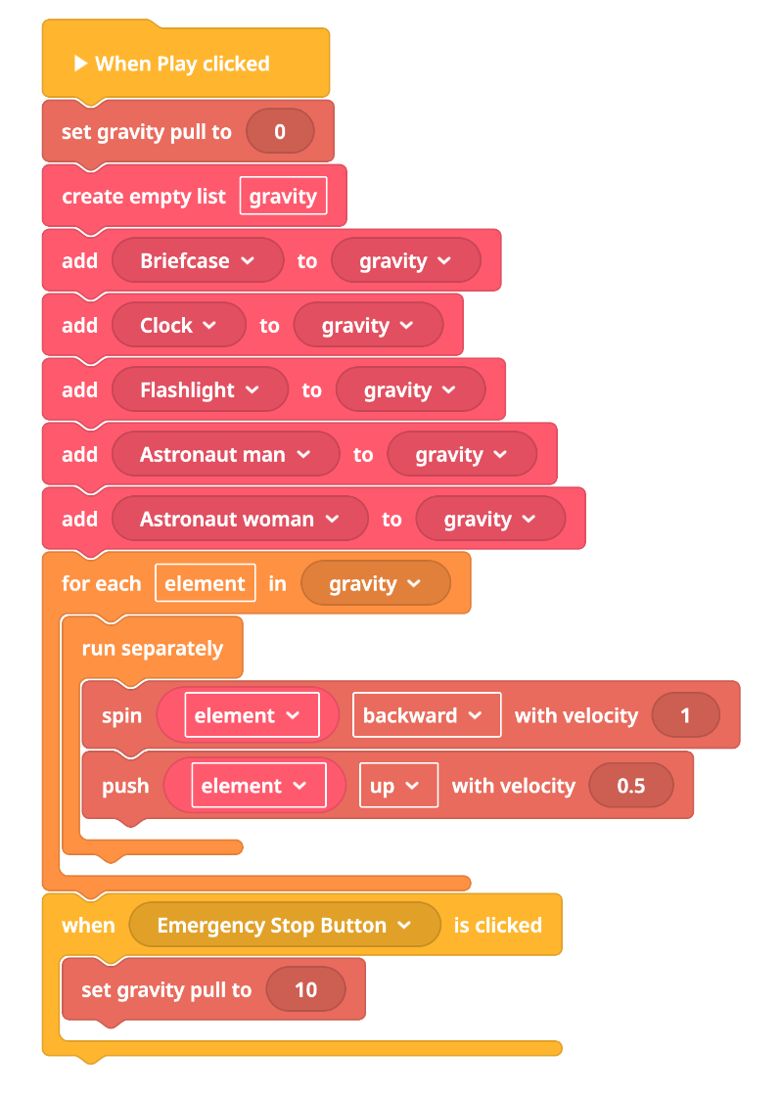
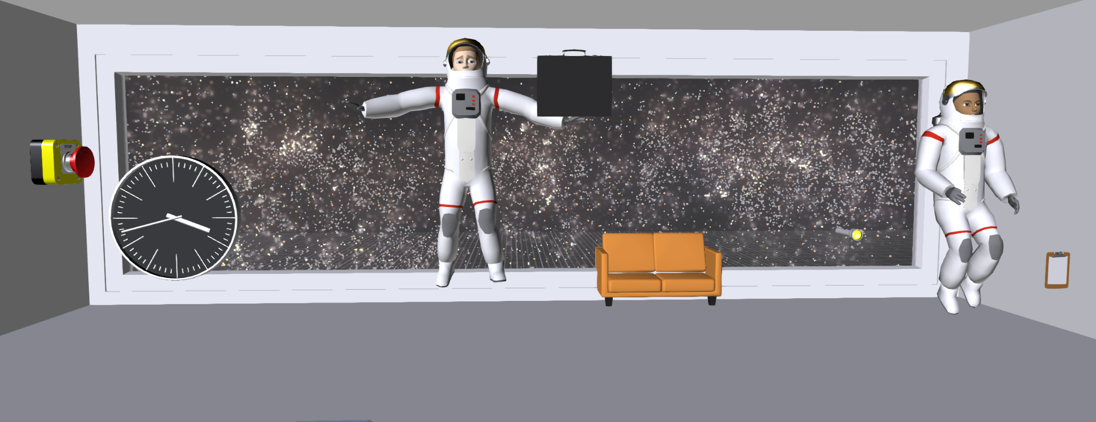
1. Set gravity pull to 0 | This sets how strong gravity is in the program. A gravity pull of 1 means things will slowly fall down, like a feather.​
Gravity Room - Teachers Version
2. Create empty list gravity​ | A list is like a box that can hold many things. Right now, the box is empty, but we’ll add things to it later.​
3. For each element in gravity​ | This means we’ll look at each item in the gravity list, one at a time. If we had 3 balls in the list, we’d do something to each ball.​
4. Run separately​ | This tells the program to do the next steps for each item, but at the same time. Like having each ball move on its own without waiting for the others.​
5 Push element up with velocity | This makes each item move upward quickly. Velocity 10 means it goes up fast, like jumping!​
https://edu.delightex.com/NVW-BYA
6 When Button Clicked
Reinstall gravity
Notes:
https://edu.delightex.com/NVW-BYA

Slide 5
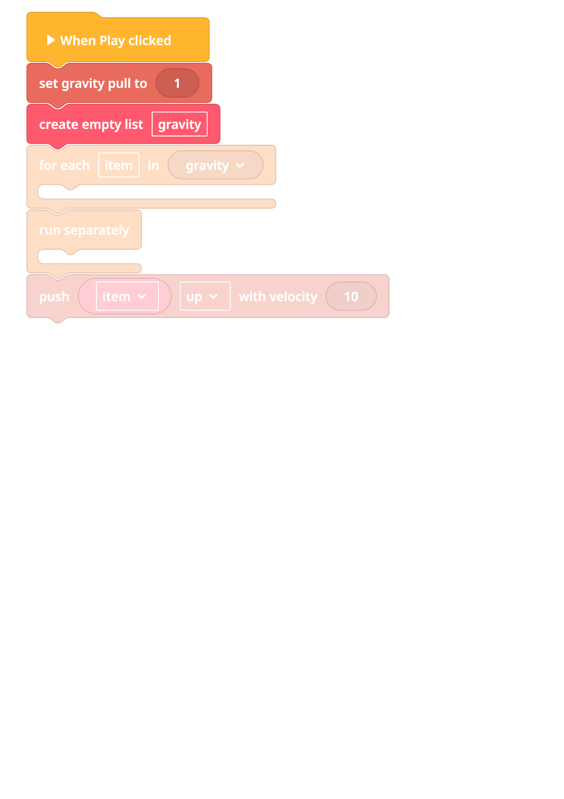
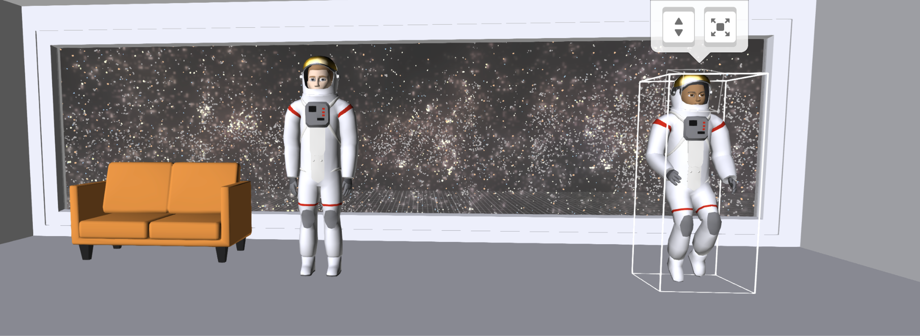
Gravity Room - Student Version
1. Set gravity pull to 1​ | This sets how strong gravity is in the program. A gravity pull of 1 means things will slowly fall down, like a feather.​
2. Create empty list gravity​ | A list is like a box that can hold many things. Right now, the box is empty, but we’ll add things to it later.​
3. For each element in gravity​ | This means we’ll look at each item in the gravity list, one at a time. If we had 3 balls in the list, we’d do something to each ball.​
*Code has been disabled*
4. Run separately​ | This tells the program to do the next steps for each item, but at the same time. Like having each ball move on its own without waiting for the others.​
5 Push element up with velocity | This makes each item move upward quickly. Velocity 10 means it goes up fast, like jumping!​
https://edu.delightex.com/NRS-SRY

Slide 6
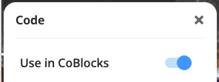
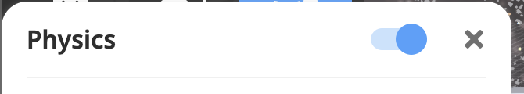
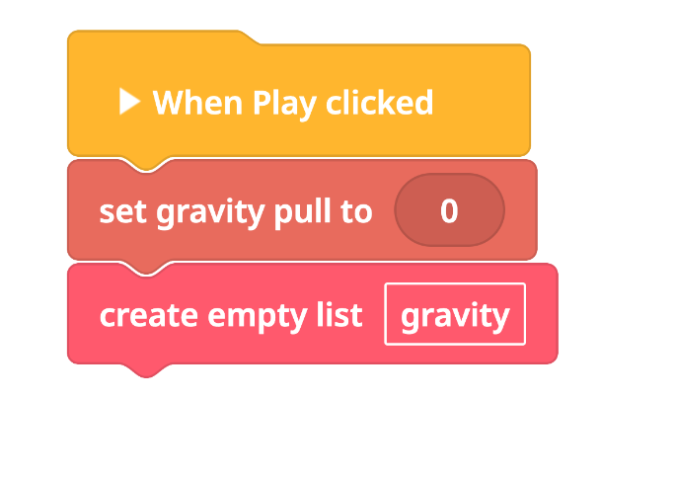
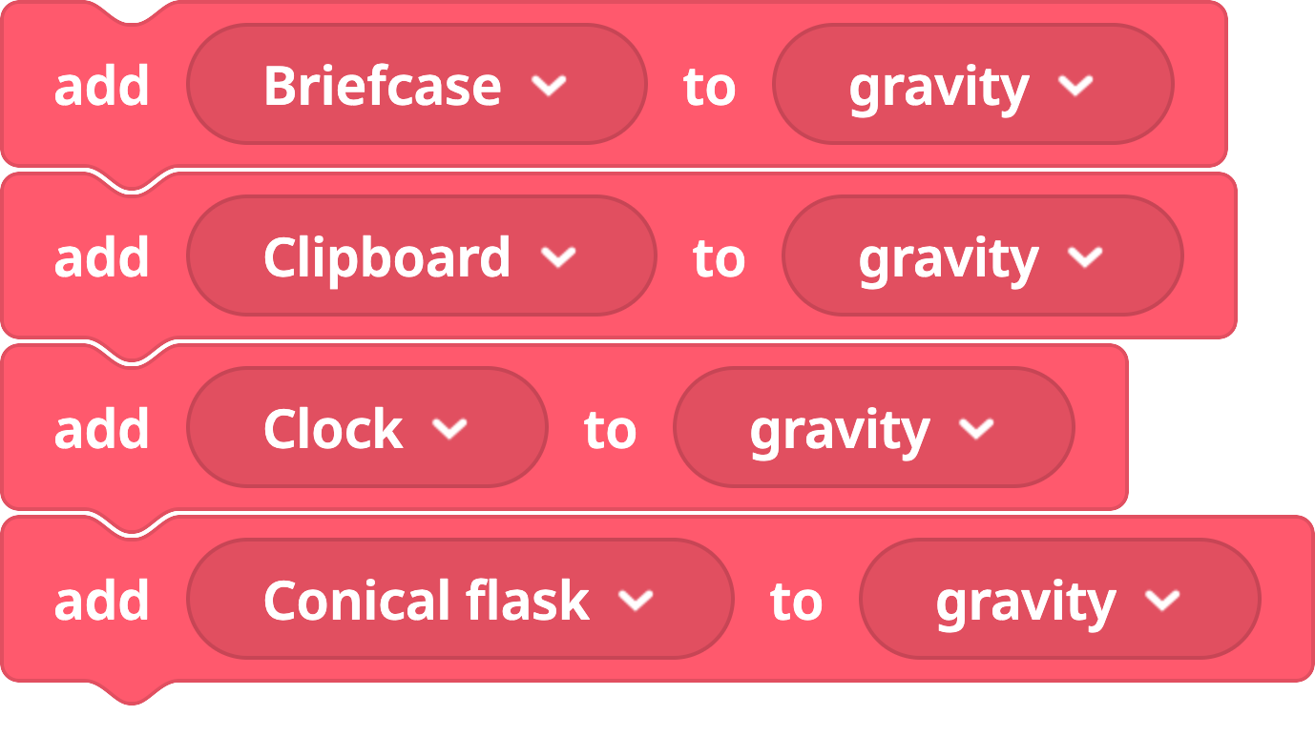
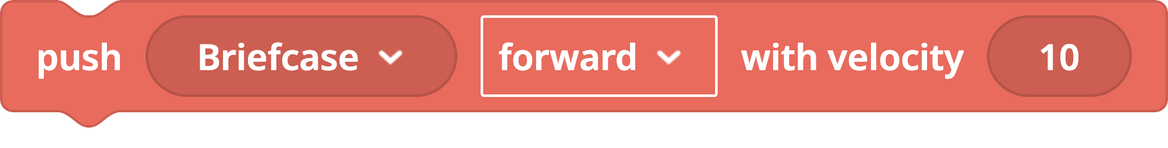
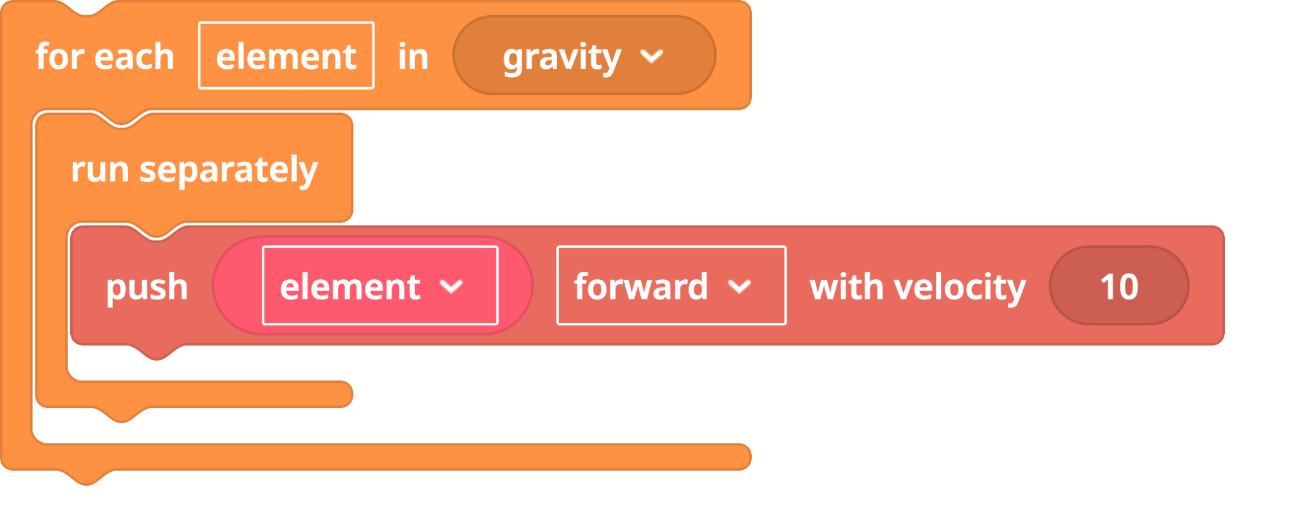
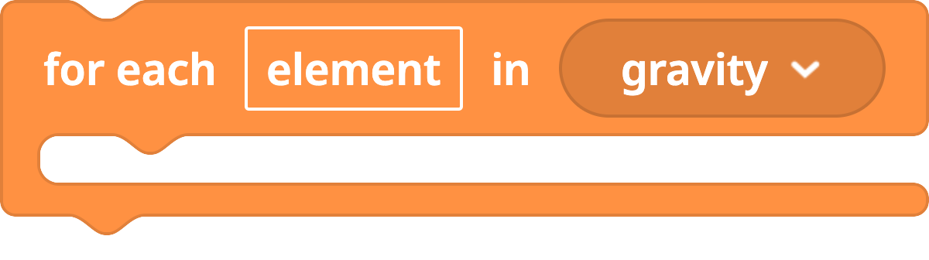
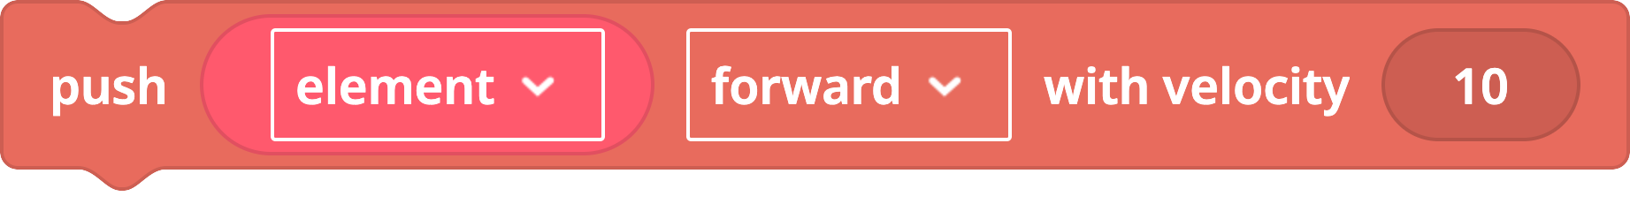
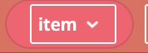
Building Student Version
Set Up the Environment
Add different objects
Implement Gravity Logic
Notes:
Remember to enable Physics for object added

Slide 7
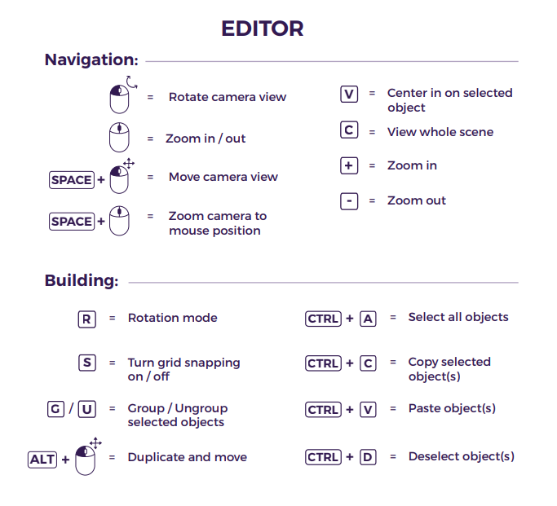
Building student version
Set Up the Environment
Add different objects
Notes:
Remember to enable Physics for object added

Slide 8
Testing Your Creations: Mini Plenary
Time to check if your Gravity Control Room is working as expected! Ask yourself these questions:
Do Objects Bounce?
Weight Differences?

Slide 9
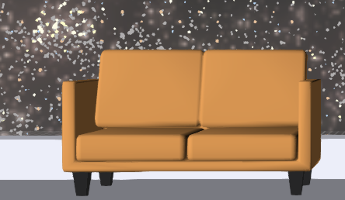
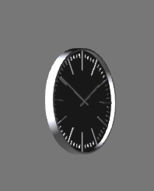
Physics in Action: Bounciness Settings
The 'bounciness' (or restitution) property controls how much energy an object retains after a collision. Think about a super bouncy ball vs. a heavy rock!
Light Objects
Heavy Objects
For objects like a clock or flash light, set their bounciness to a higher value, typically 0.6 - 0.8. This means they'll rebound with most of their initial energy.
For dense items like a rock or sofa, their bounciness should be much lower, around 0.1 - 0.2. They'll absorb most of the impact and barely bounce.

Slide 10
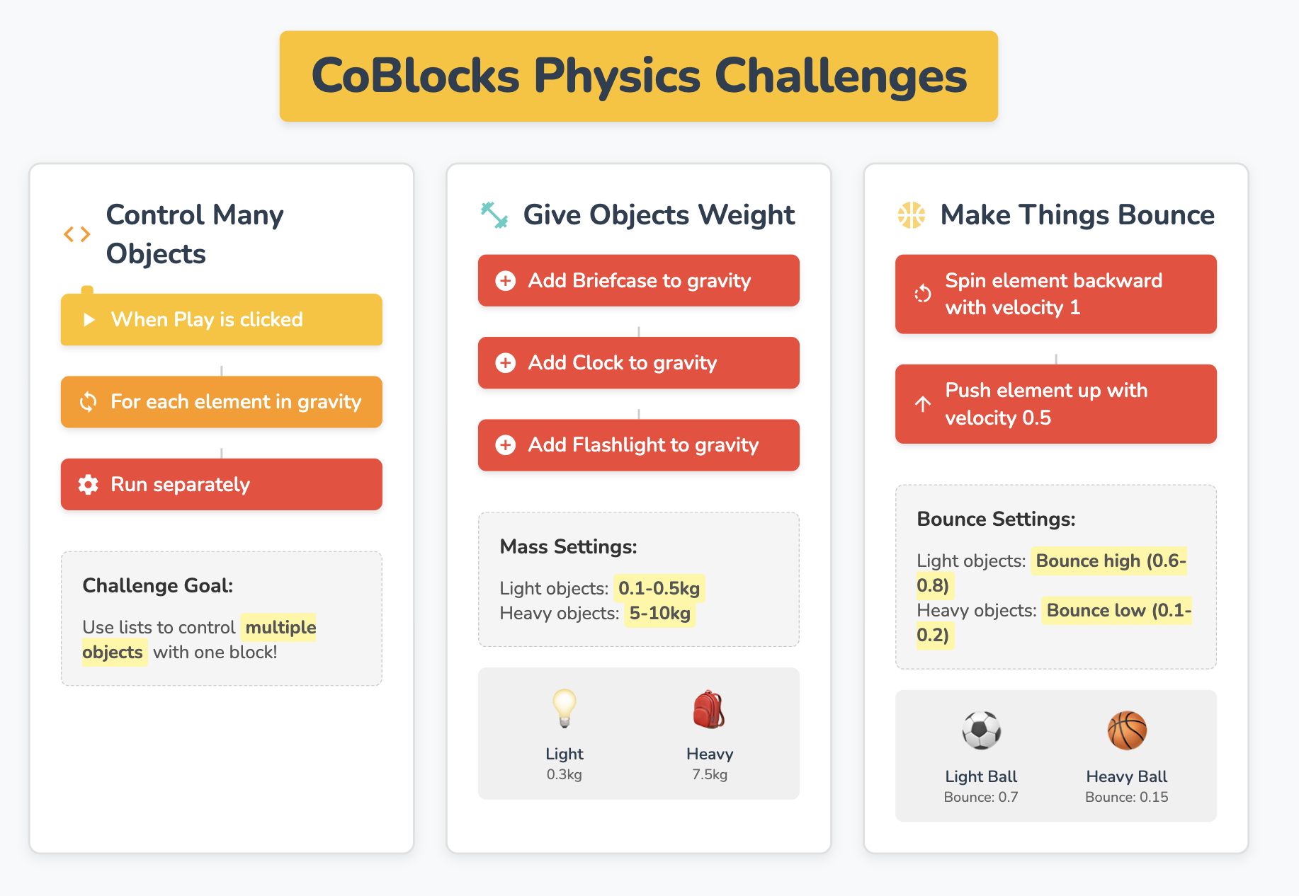
Notes:
Make sure your list successfully controls multiple objects using lists. This shows you've mastered code reusability for basic actions.
Assign realistic masses to your objects (e.g., Light: 0.1-0.5kg, Heavy: 5-10kg).
Configure their bounciness: Light objects should have bounciness between 0.6-0.8, while heavy objects should be less bouncy, at 0.1-0.2.

Slide 11
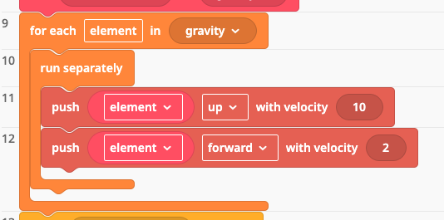
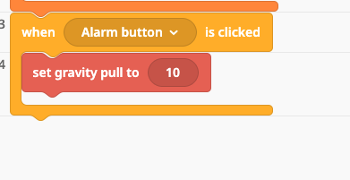
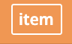
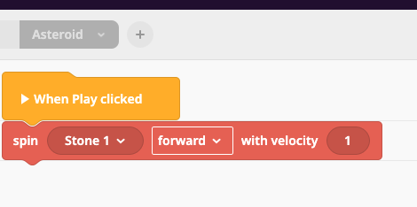
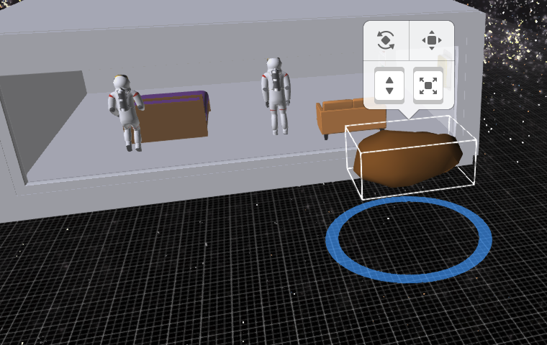
Extension ideas
Push your items in 2 directions
Create an off and on button
Add some space debris outside and make it spin

Slide 12
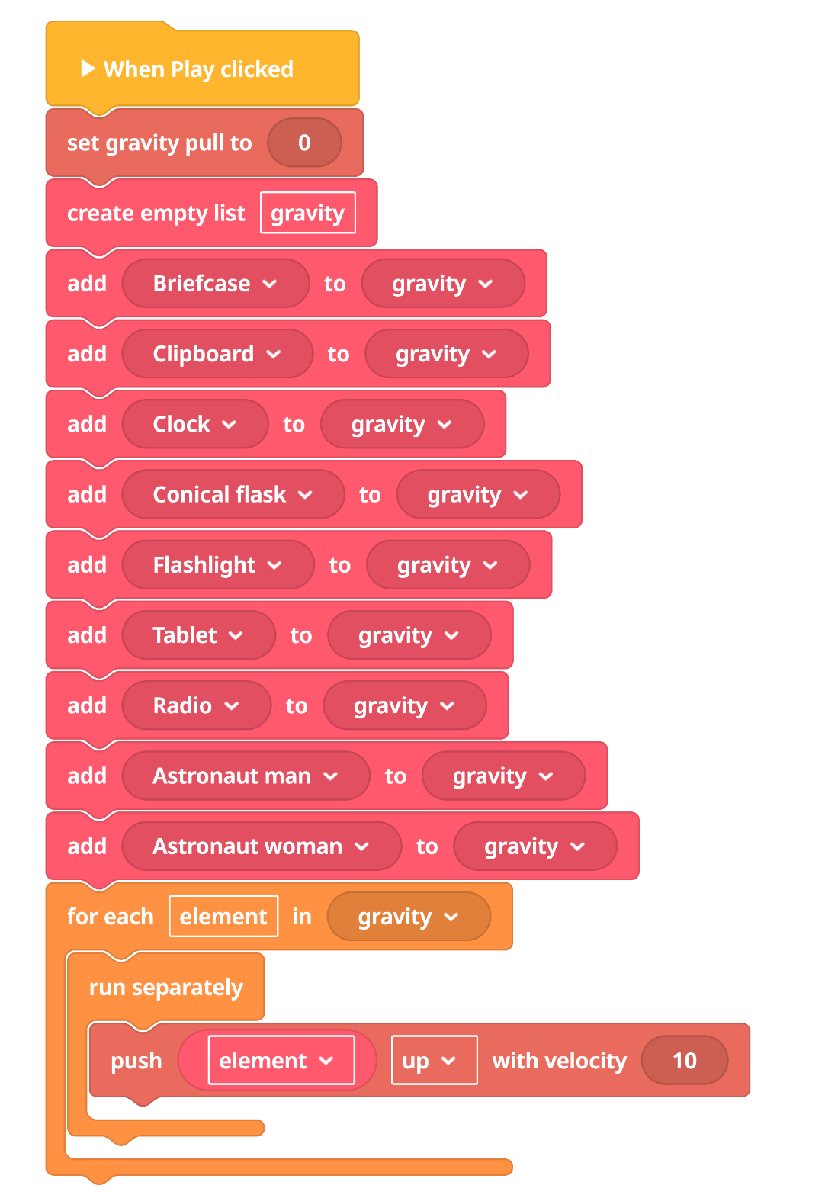
Starts when you press Play
The code begins running as soon as the Play button is clicked.
🌍 Turns off gravity
set gravity pull to 0 makes everything float—like in space!
Plenary
📦 Creates a list of objects
A list called gravity is made, and filled with items like:
🔁 Loops through each item
The code goes through each object in the list one by one.
🚀 Pushes each item upward
Every object is pushed up with a speed of 10, making it look like it's floating away.
🧠 Uses a loop to repeat actions
This is a great example of how loops can be used to apply the same action to many things.

